Slide 1
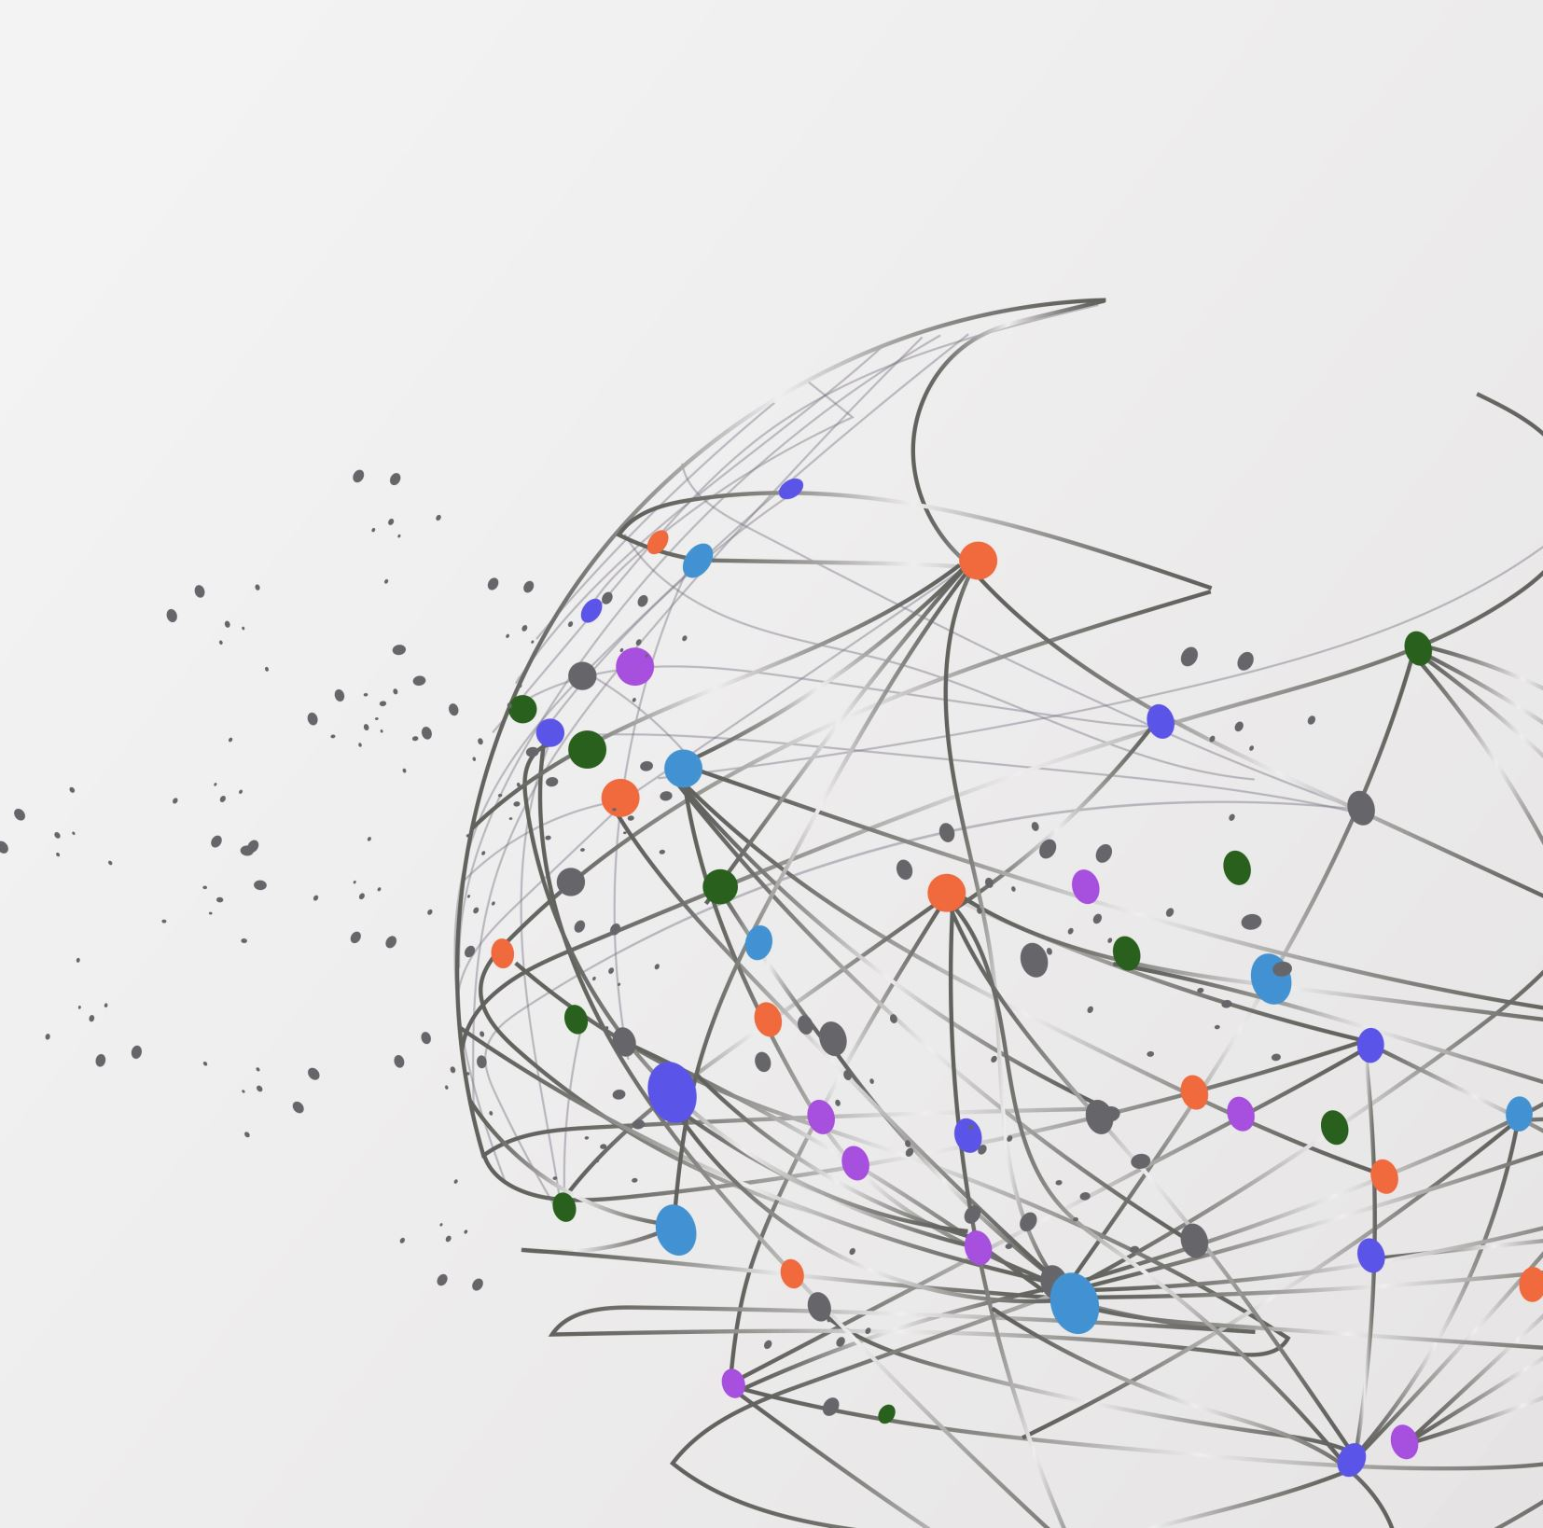
THE ISLAND WITH BEAR GRYLLS
BY LEO XU, SPENCER LOW,
ANDREW HALL

Slide 2


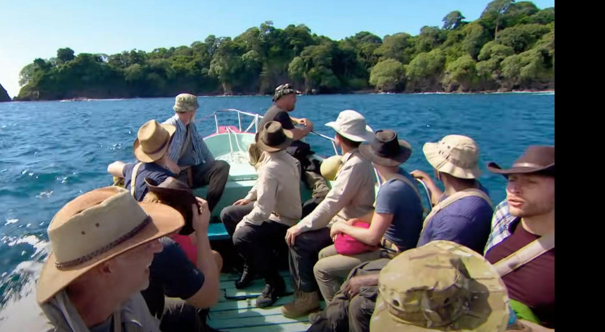
WHAT IS THE SHOW ABOUT?
TWO UNINHABITED PACIFIC ISLANDS
14 BRITISH MEN AND 14 BRITISH WOMEN MUST ATTEMPT TO SURVIVE FOR 6 WEEKS
EPISODES ALTERNATE BETWEEN MEN AND WOMEN
OPPORTUNITY TO PROVE THEMSELVES IN SURVIVAL SITUATIONS
THEY ONLY HAVE 2 DAYS OF SURVIVAL TRAINING
RETURNING TO THEIR PRIMITIVE ROOTS
ISOLATED FROM SOCIETY
LIMITED RESOURCES

Slide 3
WHAT ARE WE TRYING TO FIND?
Studying the relationships formed during a season of Bear Grylls the Island
We want to study how social networks influence different survival strategies and affect group dynamics in extreme environments

Slide 4
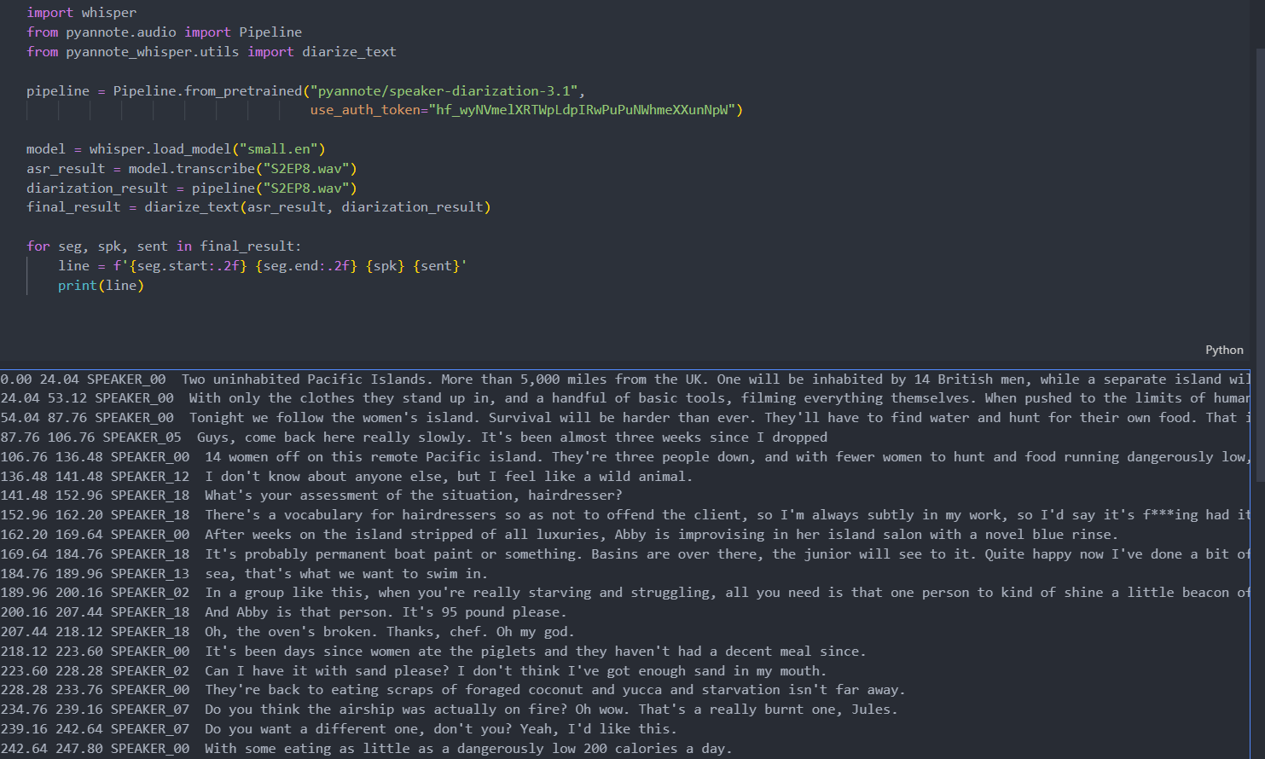
CREATING THE DIALOGUE

Slide 5


PRE-TRAINED ML ALGORITHMS WE LEVERAGED:
HTTPS://GITHUB.COM/PYANNOTE/PYANNOTE-AUDIO
PYTHON OPEN-SOURCE TOOL KIT -
SPEECH DIARIZATION (SPEECH ACTIVITY)
HTTPS://GITHUB.COM/OPENAI/WHISPER
SPEECH RECOGNITION MODEL
(TRANSLATION)
HTTPS://GITHUB.COM/YINRUIQING/PYANNOTE-WHISPER
COMBINES WHISPER AND PYANNOTE
LACK OF PUBLIC OFFICIAL SUBTITLES OR SCRIPT
FOR HIGHER DIALOGUE ACCURACY
EASIER FOR ANALYSIS AND EFFICIENCY
USEFUL TO HAVE A FULL TRANSCRIPT ON HAND AS RECORD TO MODIFY
FASTER THAN MANUAL TRANSCRIPTION
(pyannote, n.d)
(Vincent, 2023)

Slide 6
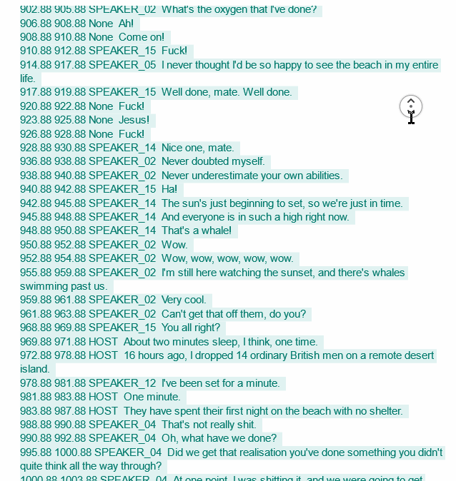
ORIGINAL TRANSCRIPT
WE GENERATED FOR EP1:
APPROX. 20-30 PAGES OF DIALOGUE PER EPISODE
VERY INACCURATE WHEN DIFFERENTIATING SPEAKERS, SOME MISTAKES WHEN TRANSLATING, BUT ADEQUATE FOR THE TIME IT TAKES
40MINS ~ 1HR FOR GENERATION PER EPISODES + 29 TOTAL VOICES (+14 PER GROUP AND THE HOST)
THIS IS SOMETHING WE FIX DURING THE EPISODES

Slide 7
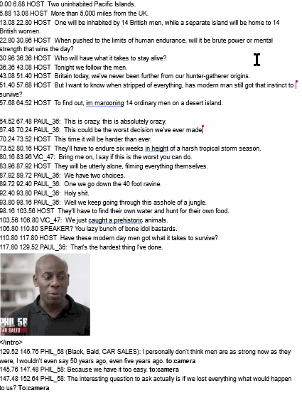
EXAMPLE:
EP 1. AFTER ANALYSIS
FIX DIALOGUE INACCURACIES
ADD SPEAKER NAMES TO DIALOGUE
RECORD MOMENTS OF SIGNIFICANT POSITIVE AND NEGATIVE INTERACTION
MOMENTS OF CONFLICT
WHO IS INVOLVED IN KEY MOMENTS
TIMESTAMP OF WHEN IT HAPPENS

Slide 8
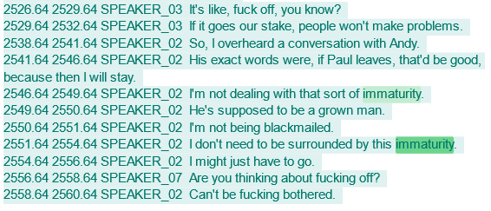
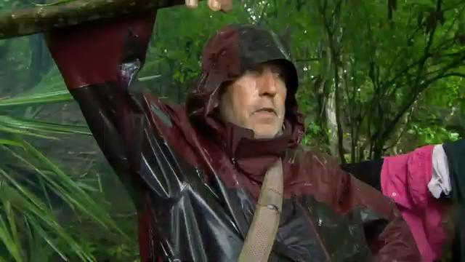
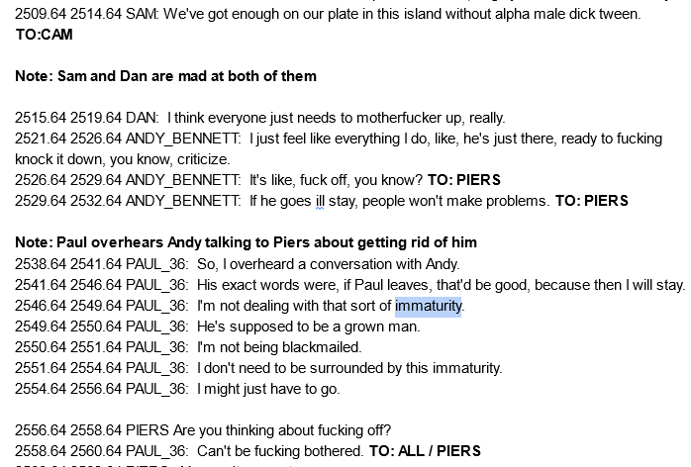
EXAMPLE: TRANSCRIPT BEFORE-AFTER

Slide 9

NEGATIVE INTERACTION
GUIDELINES FOR CLASSIFYING INTERACTIONS:
NEGATIVE:
ARGUMENT
DISAGREEMENT
TALKING BEHIND AN INDIVIDUAL’S BACK
FIGHTING
LEAVING GROUP BEHIND
FAILING TO MEET THE GROUPS EXPECTATIONS
HARMFUL FEELINGS TOWARDS ANOTHER PERSON IN THE GROUP

Slide 10
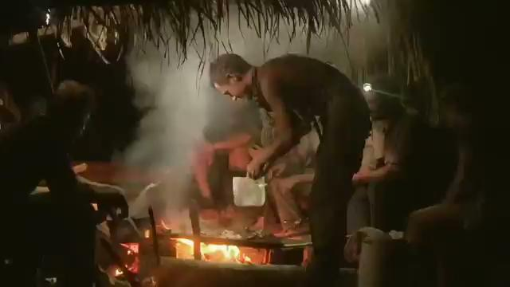
POSITIVE INTERACTION
GUIDELINES FOR CLASSIFYING INTERACTIONS:
POSITIVE:
LAUGHTER
TEAMWORK
PHYSICAL TOUCH (HUGGING, PATTING ON BACK)
COMMUNAL DINING
COMPLIMENTS
ACTIONS DONE IN BENEFIT OF THE GROUP
BONDING THROUGH CONVERSATIONS
SHARING PERSONAL STORIES
ANYTHING THAT YOU WOULD SEE TWO FRIENDS DO NORMALLY.

Slide 11
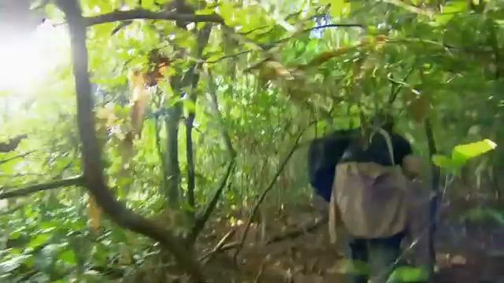
NEUTRAL INTERACTION
GUIDELINES FOR CLASSIFYING INTERACTIONS:
NEUTRAL:
MINIMAL INTERACTION
NOT TALKING WITH EACH OTHER
UNBOTHERED IN THE INTERACTION
NO POSITIVE OR NEGATIVE FEELINGS TOWARDS OTHERS
NO SIGNIFICANT CHANGE TO BONDS
EXAMPLE: THIS IS OFTEN SEEN IN THE FIRST MOMENT THE PARTICIPANTS ARRIVE TO THE ISLAND, FAR MORE LIKELY TO BE RESERVED. EXCHANGING OF INFORMATION

Slide 12
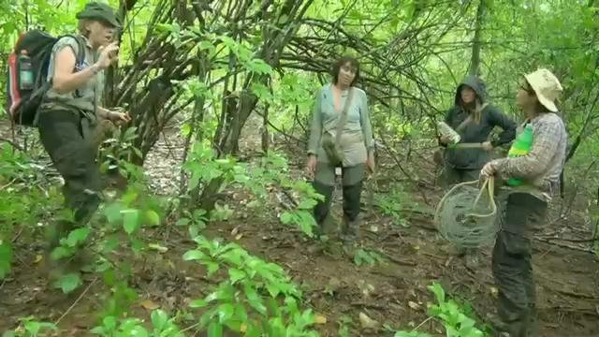
MIXED INTERACTIONS:
SOME INTERACTIONS ARE SLIGHTLY MORE COMPLICATED -HAS BOTH POSITIVE/NEGATIVE
SEVERAL PEOPLE INTERACTING AT THE SAME TIME
NEED TO DETERMINE ALLIES AND ENEMIES OF EACH PERSON

Slide 13

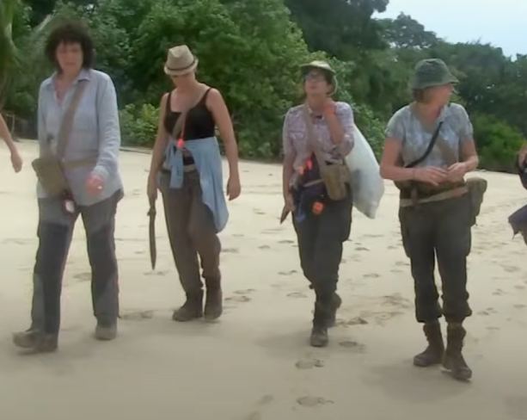
RELATIONSHIP GRAPHS

Slide 14
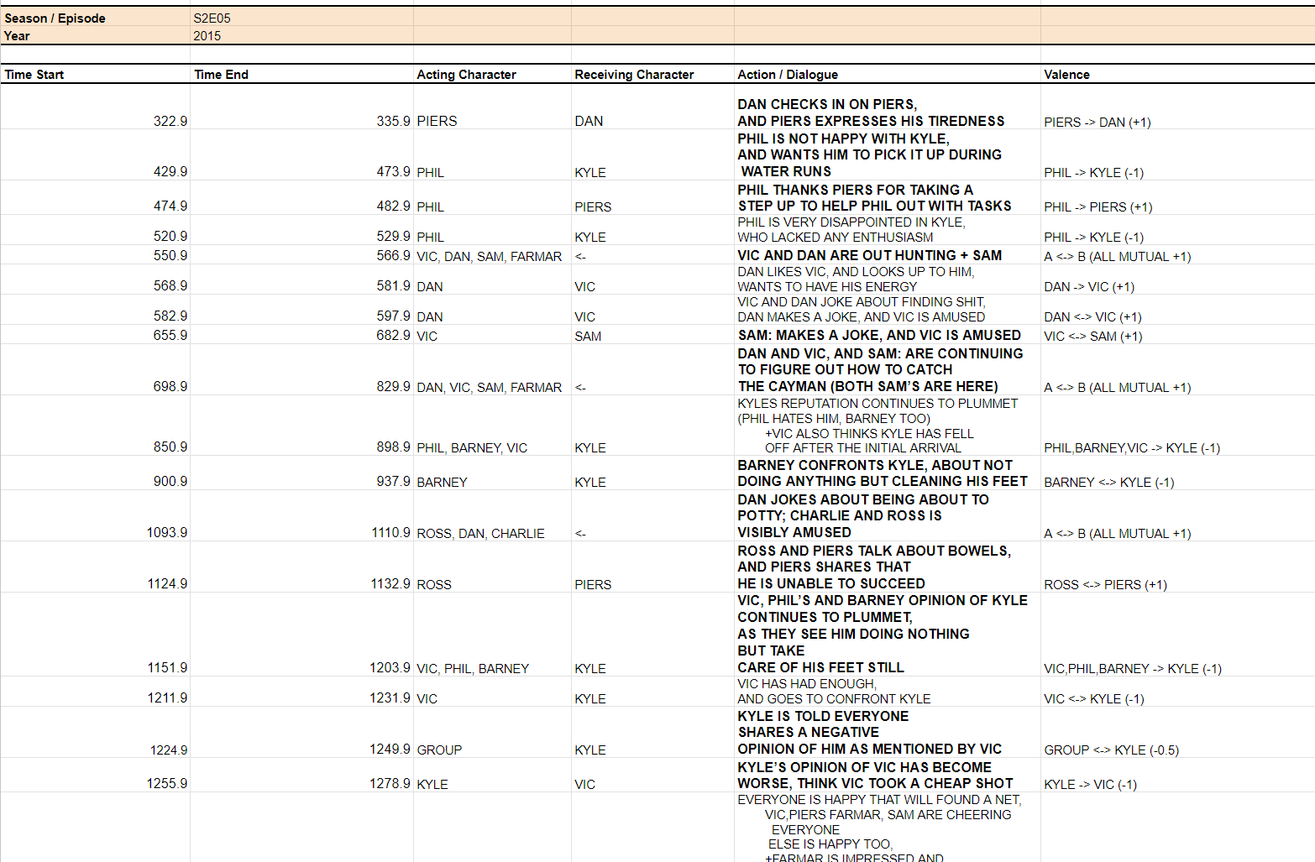

Slide 15
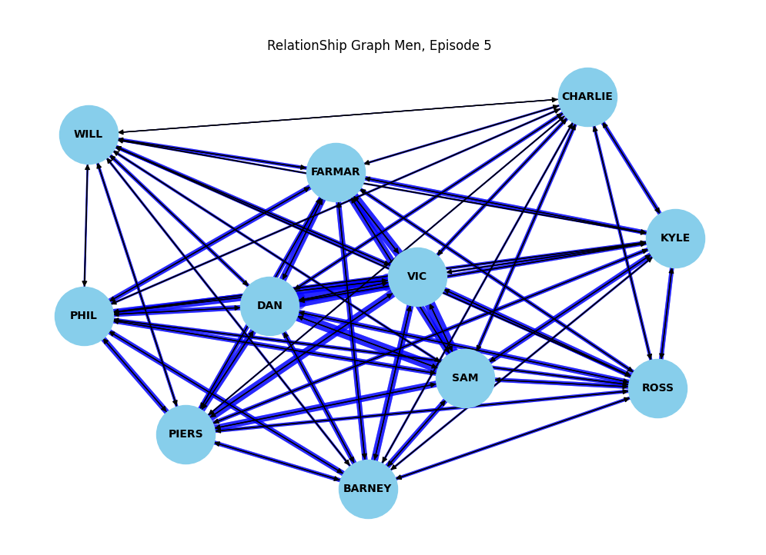

Slide 16
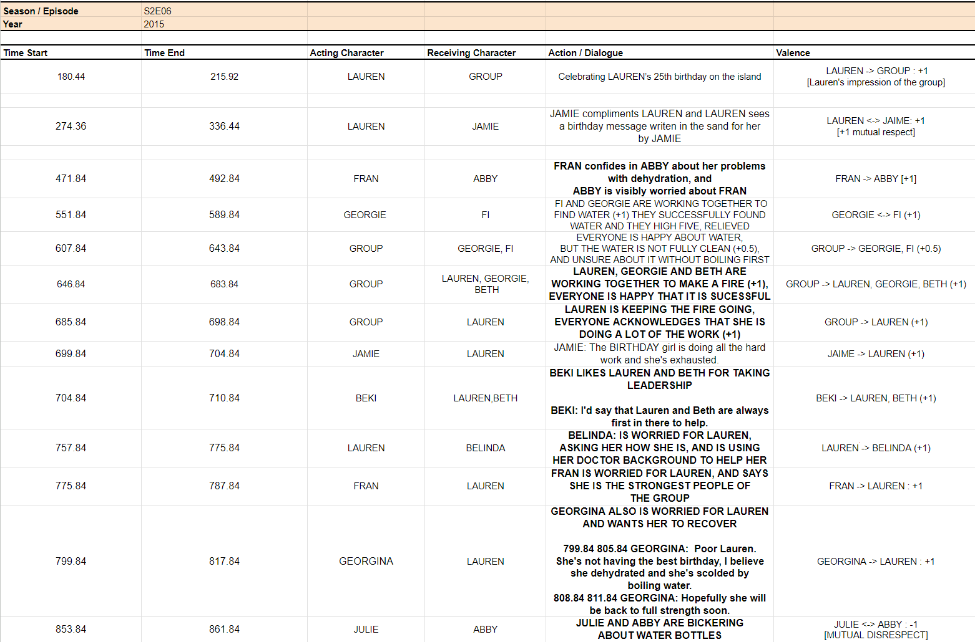

Slide 17
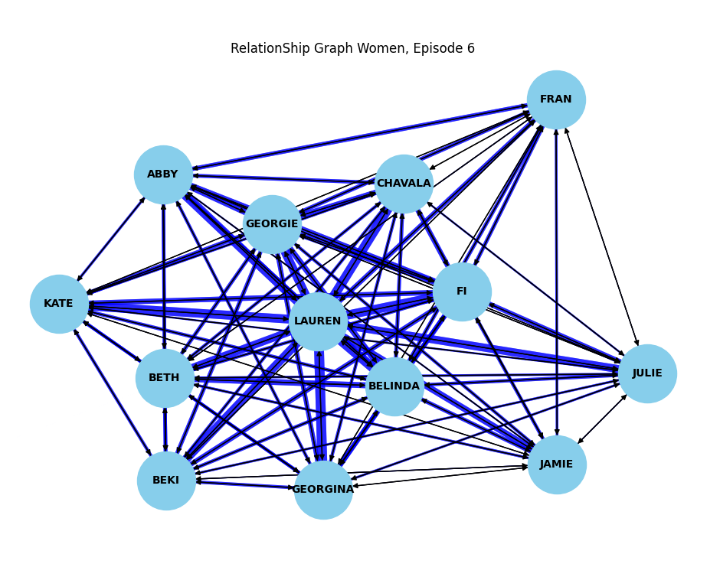

Slide 18
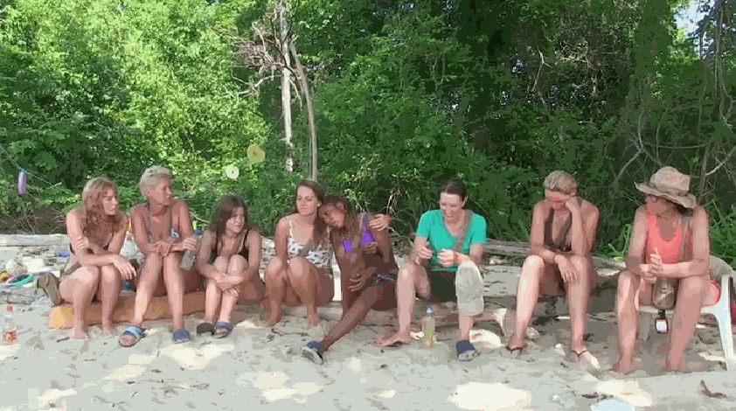
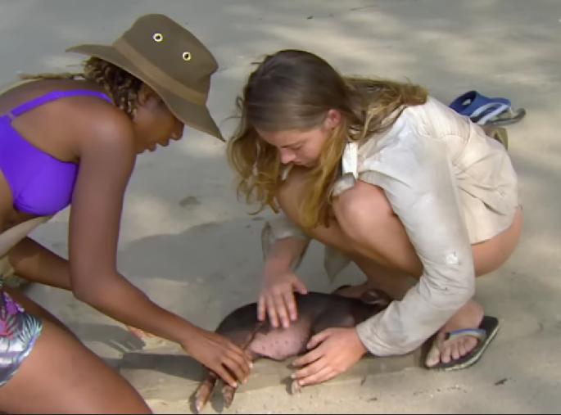
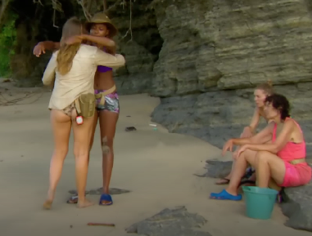
LEADERS AND INITIATIVE
THOSE WHO TAKE INITIATIVE, AND LEAD ARE
BECOME CENTRAL FIGURES OF THEIR GROUPS
OFTEN GIVEN TO THOSE
+HELP GETTING NECESSITIES
FIRE, WATER, FOOD
+ BUILDING, KILLING ANIMALS
+ SUCCESSFULLY LEAD THE GROUP DURING TASKS
ANYTHING BENEFITING THE GROUP

Slide 19
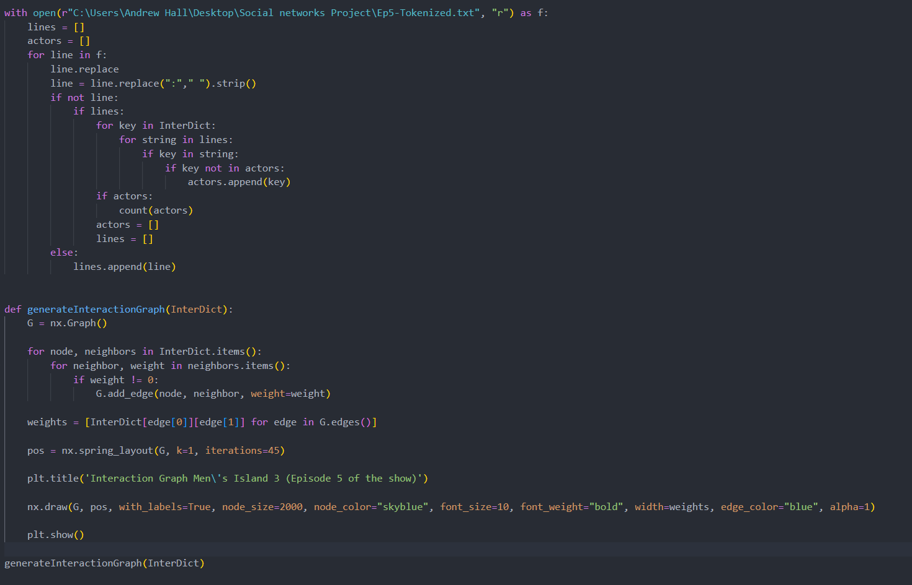
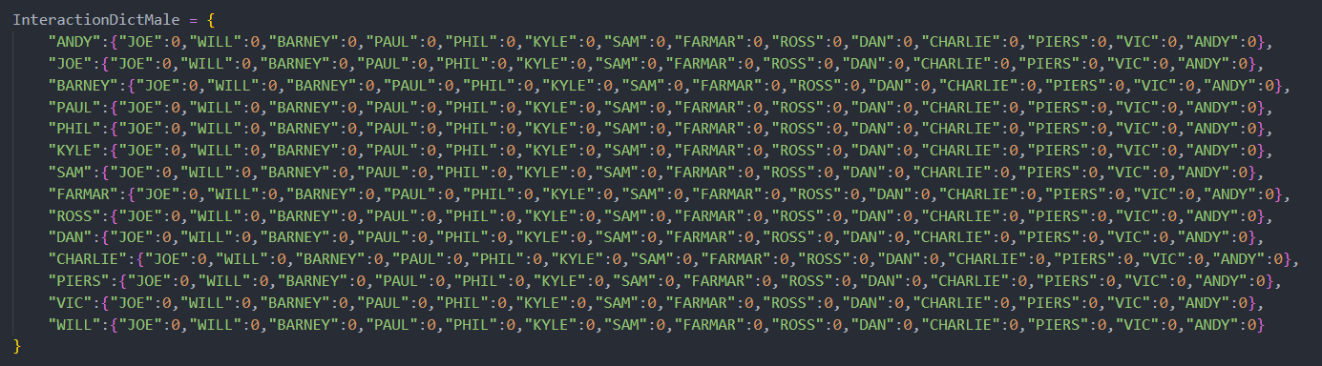
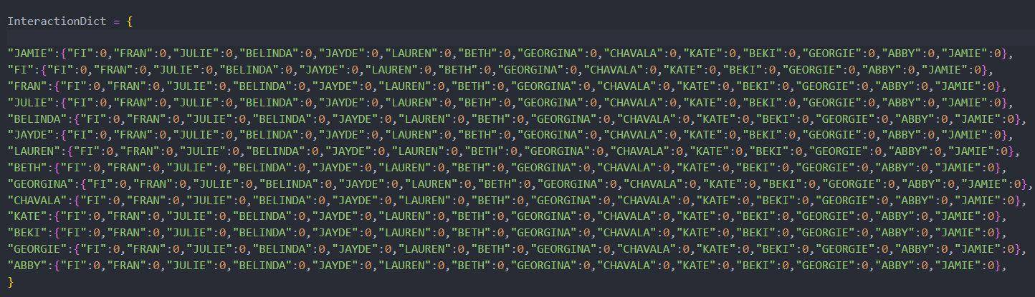

Slide 20
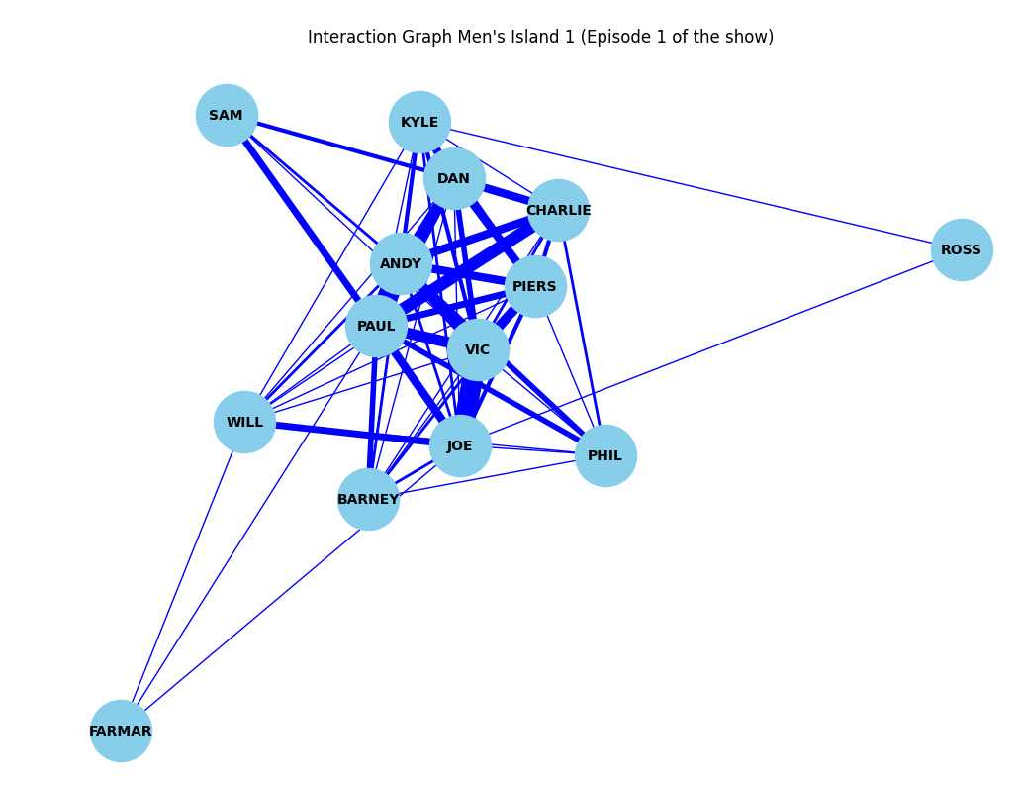
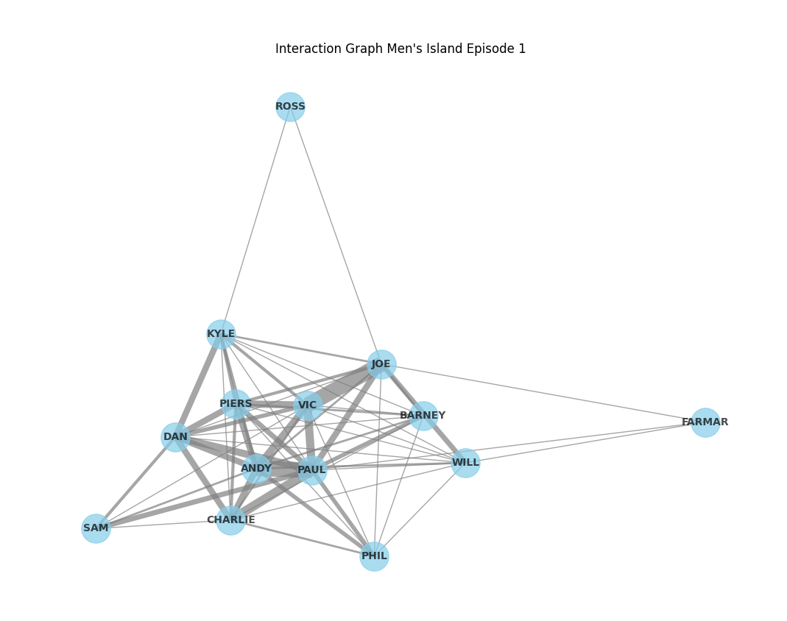

Slide 21
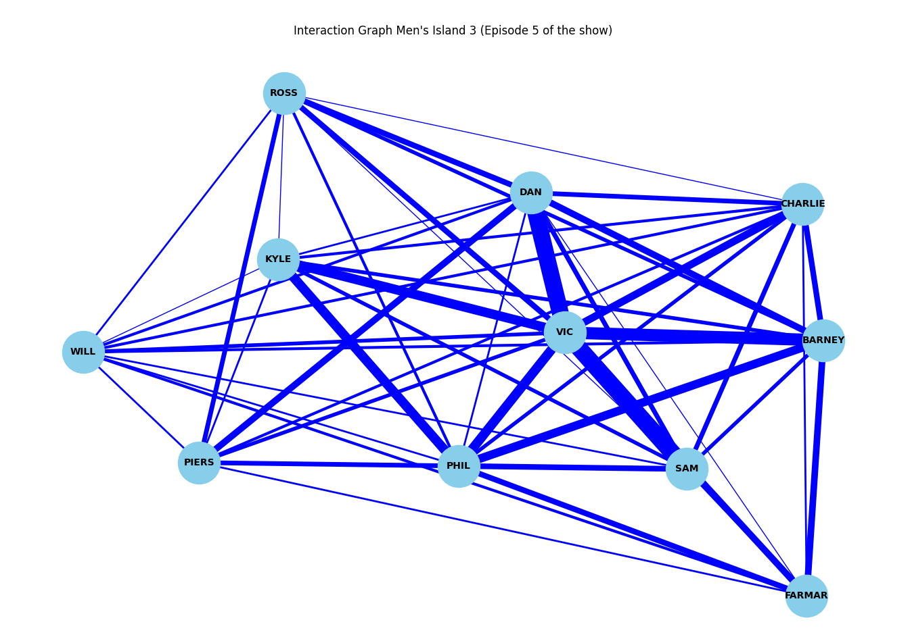
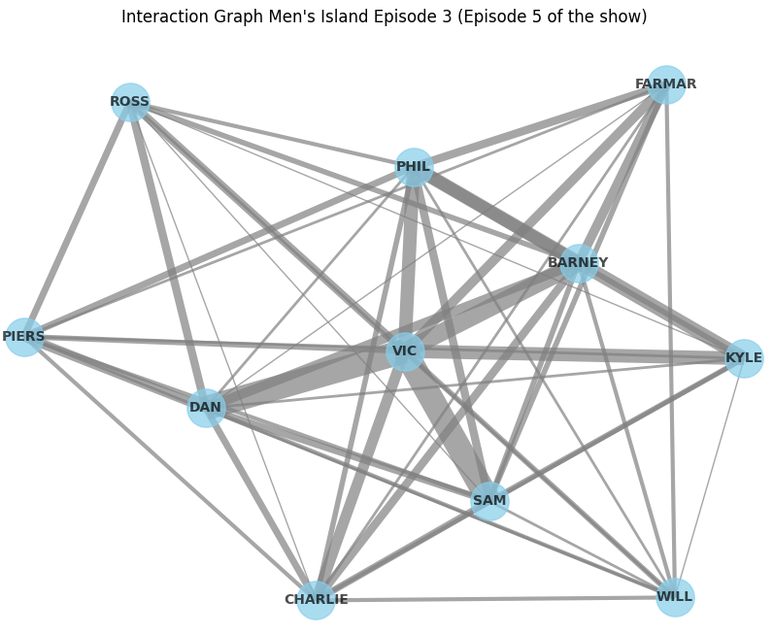

Slide 22
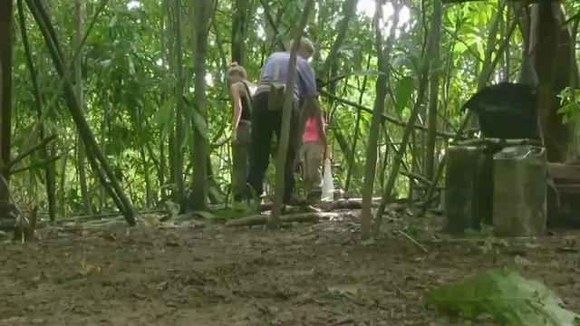
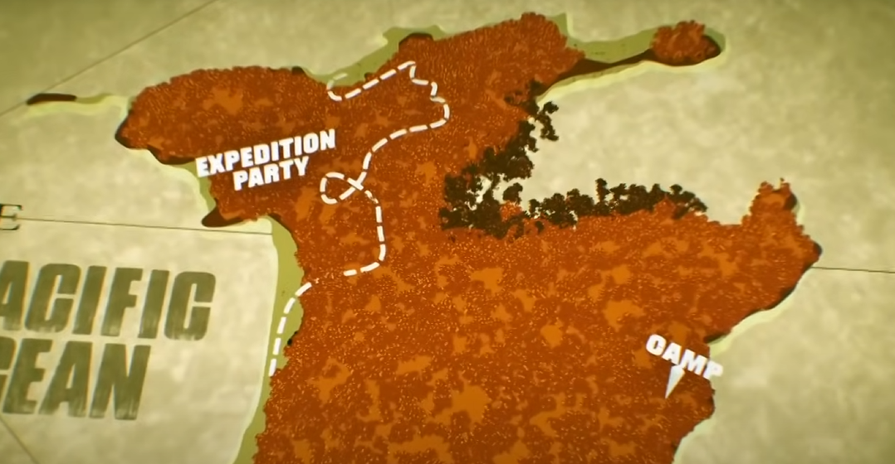
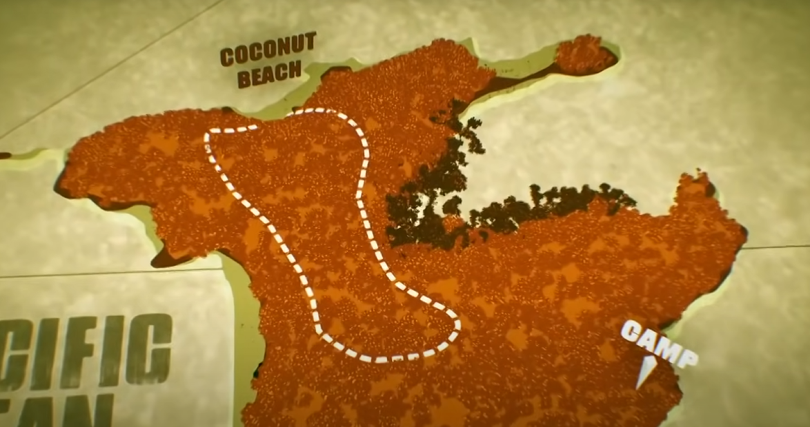
GROUP DIVISION
THE WOMEN’S GROUP SPLITS UP TO FIND BEACH IN EPISODE 2
LEAVES TWO ISOLATED GROUPS
SHOWS WHO TAKES INITIATIVE WHEN THERE ARE DRASTIC CHANGES TO GROUP DYNAMICS

Slide 23
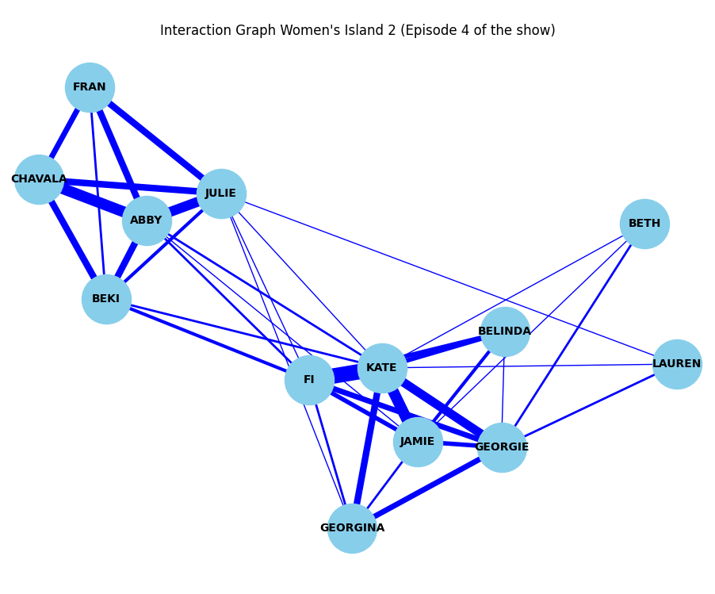
DELEGATES TASKS
DECIDES FOR THE GROUP
CHANGES OVER TIME

Slide 24
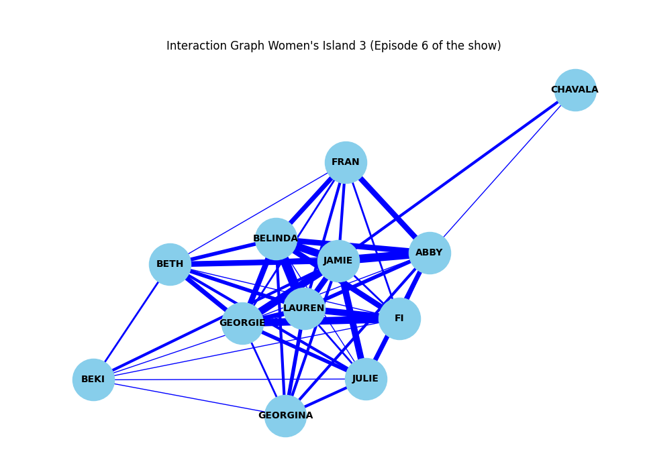
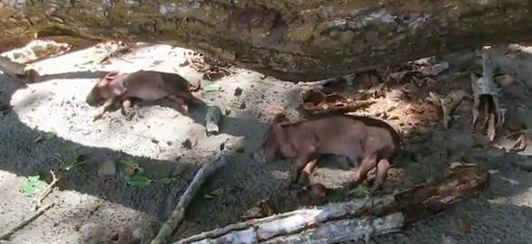

PIGLET PETS
LEADERSHIP FAILURE
CHARACTER DEVELOPMENT

Slide 25

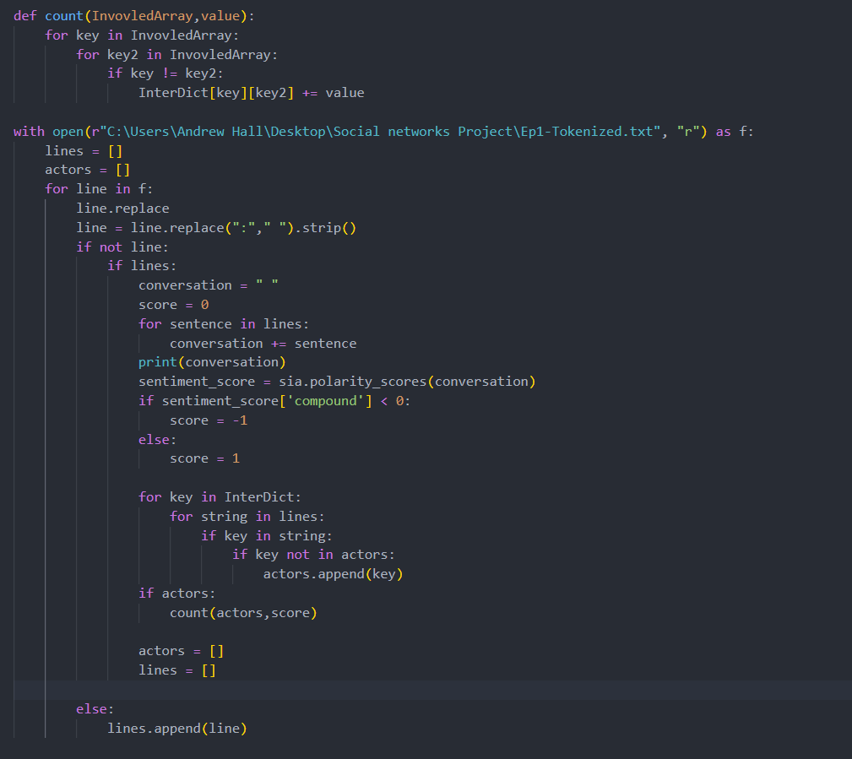
(Kelsy, 2021)
Hutto, C.J. & Gilbert, E.E. (2014). VADER: A Parsimonious Rule-based Model for Sentiment Analysis of Social Media Text. Eighth International Conference on Weblogs and Social Media (ICWSM-14). Ann Arbor, MI, June 2014.
Output:

Slide 26
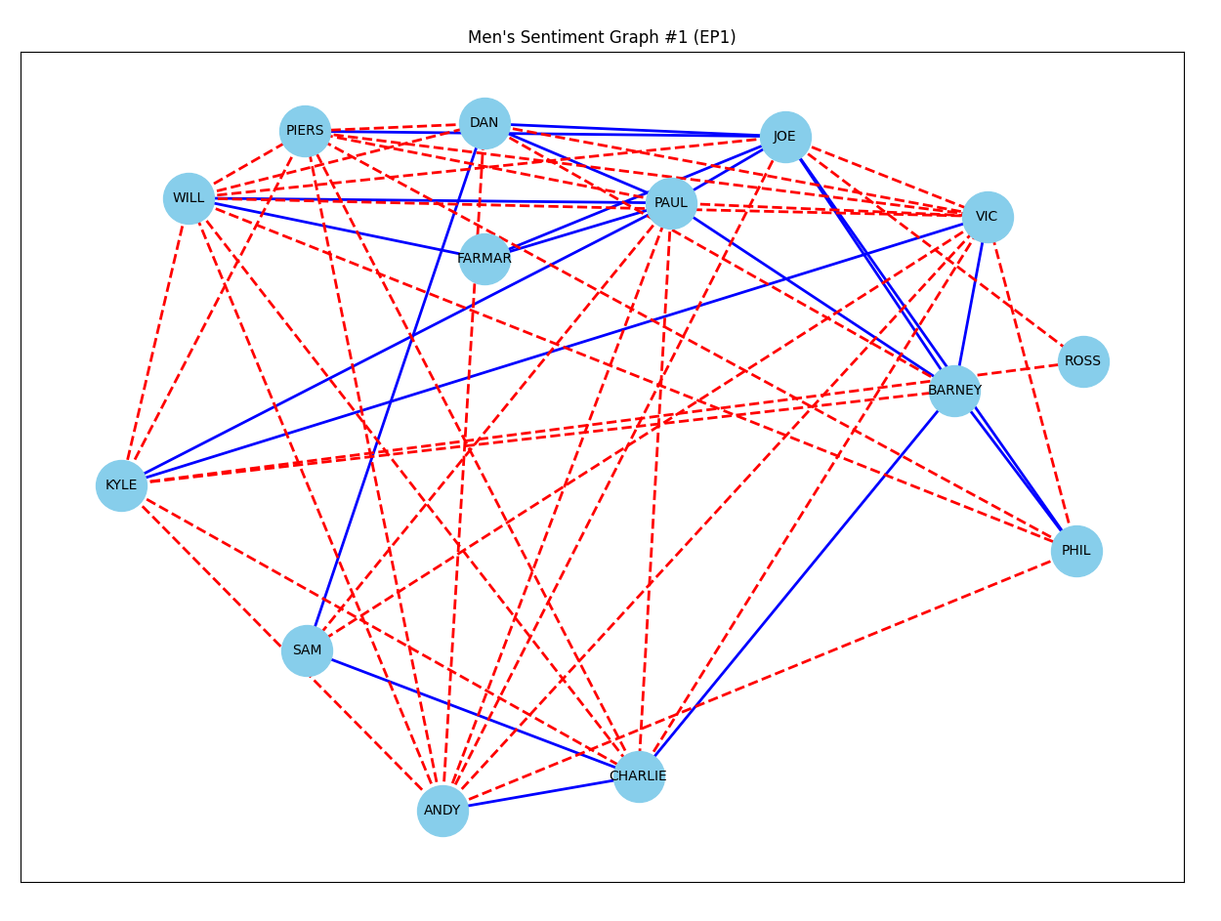

Slide 27
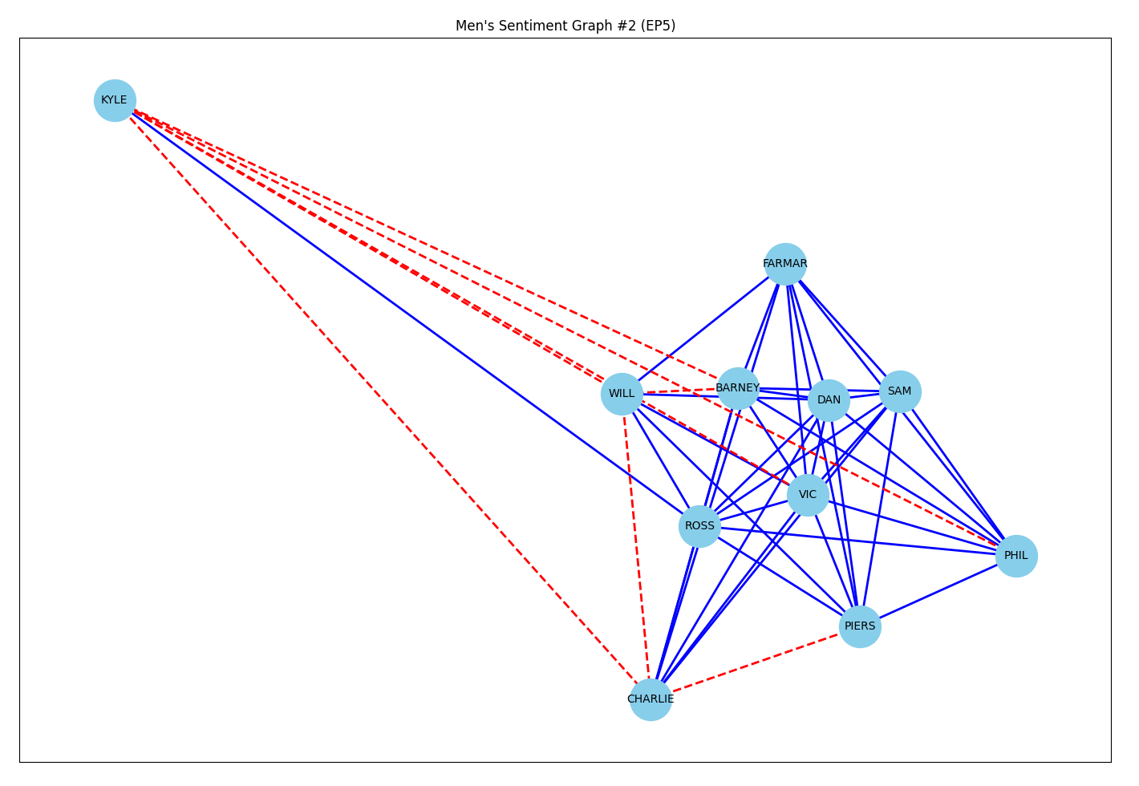

Slide 28
FUTURE PLANS
FINISH WATCHING ALL THE EPISODES
WE HAVE CURRENTLY ONLY GONE THROUGH HALF OF THE DATA COLLECTION
CREATE AND GENERATE ALL REMAINING INTERACTION AND RELATIONSHIP GRAPHS
LOOK AT DEGREE DISTRIBUTION AND COLLECTIVE ACTION
GENERATE GRAPHS OFF THE COMPLETE DATA SET
CONTINUE ANALYZING THE SURVIVORS, THEIR RELATIONSHIPS, MOOD SWINGS, AND EVENTS

Slide 29
References
Aric A. Hagberg, Daniel A. Schult and Pieter J. Swart, “Exploring network structure, dynamics, and function using NetworkX”, in Proceedings of the 7th Python in Science Conference (SciPy2008), Gäel Varoquaux, Travis Vaught, and Jarrod Millman (Eds), (Pasadena, CA USA), pp. 11–15, Aug 2008 Grylls, Bear. Mitchell, Ben. Shoopman, Delber. Whitwell, Tim. (Executive Producers). (2015-2015). The Island with Bear Grylls S2 [TV series]. Shine TV; Bear Grylls Ventures.
J. D. Hunter, "Matplotlib: A 2D Graphics Environment", Computing in Science & Engineering, vol. 9, no. 3, pp. 90-95, 2007.
Lane, Kelsey. “The Natural Language Toolkit - What Is It?” Medium, Medium, 27 Sept. 2021, medium.com/@kelsklane/the-natural-language-toolkit-what-is-it-8ca335dce6a9.
Pyannote. (n.d.). Pyannote. PyAnnote. https://pyannote.github.io/ Vincent, J. (2023, March 15). OpenAI co-founder on Company’s past approach to openly sharing research: “we were wrong.” The Verge. https://www.theverge.com/2023/3/15/23640180/openai-gpt-4-launch-closed-research-ilya-sutskever-interview

Slide 30
ANY QUESTIONS?

